Slide 1
What is ReactJS?
Is an open-source front-end JavaScript library for building user interfaces.
Is maintained by Facebook and a community of individual developers and companies.
Widely used as a base in building single-page websites and mobile applications.
Very easy to use, and it allows users to create reusable UI components.

Slide 2

Who is using React?

Slide 3
Advantages of using ReactJS
High performance:
ReactJS uses a virtual DOM, which can significantly improve the performance of our applications.
Reusable components:
ReactJS components are highly reusable, which can save a lot of time and effort when developing the applications.

Slide 4
Flexible:
React is a library, not a framework, which gives you more flexibility in how you build your application.
Scalable:
Can use it to create large and complex applications.
Community support:
React has a large and active community of developers. This means that there are many resources available to help you learn and use React.

Slide 5
Server-Side Rendering (SSR):
The server can render React components to HTML before sending it to the client, making web pages more search engine-friendly and faster to load.

Slide 6
Why we use ReactJS?
Objective of ReactJS is to develop User Interfaces (UI) that improves the speed of the apps.
Uses virtual DOM (JavaScript object), which improves the performance of the app.
JavaScript virtual DOM is faster than the regular DOM.
Can use ReactJS on the client and server-side as well as with other frameworks.
Uses component and data patterns that improve readability and helps to maintain larger apps.

Slide 7
Why virtual DOM is required?
React is designed for managing updates to pages.
Because of the Virtual DOM, each change to the data model can trigger a complete refresh of the virtual user interface.
The Virtual DOM often actually uses less memory than other systems.

Slide 8
DOM (Document Object Model)
When a web page is loaded, the browser creates a Document Object Model of the page.
The HTML DOM model is constructed as a tree of Objects
Is heavy and slow to update, so it is not ideal for updating UIs frequently.

Slide 9
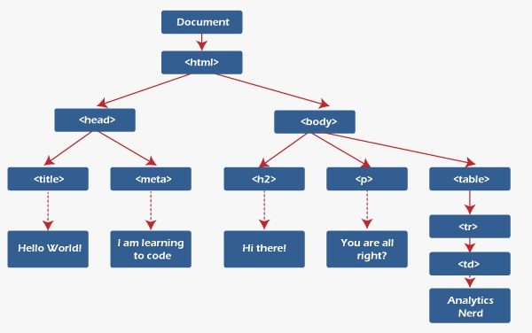

Slide 10
How does React Work?
Instead of manipulating the browser's DOM directly, React creates a virtual DOM in memory, where it does all the necessary manipulating, before making the changes in the browser DOM.

Slide 11
How Virtual DOM Works
Process consist of 3 main steps:
Rendering the entire UI into Virtual DOM when there’s a change in UI.
Calculating the difference between previous and current Virtual DOM representations.
Updating the real DOM with the changes.

Slide 12
When you update a component, React compares the virtual DOM to the real DOM and only updates the real DOM when necessary.
This makes React applications very fast and responsive.

Slide 13
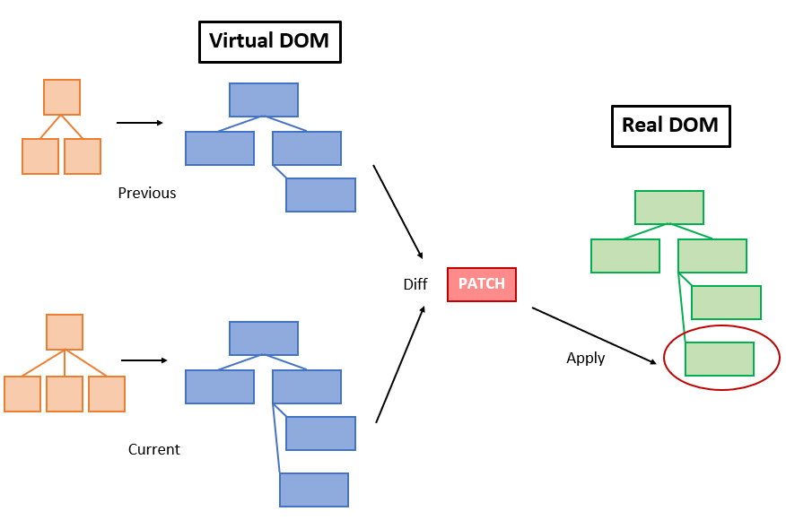

Slide 14
Setting up a React Environment

Slide 15
Requirements
To create a React Project using create-react-app, we need to have installed the following things in our system.
Node version >= 8.10
NPM version >= 5.6
NPM:Node Package Manager
NPX: Node Package Execute a

Slide 16
To check the current version of Node and NPM in the system.
Run the following command to check the Node version in the command prompt.
node -v
npm -v

Slide 17
Installation:
Install React: npm install -g create-react-app
Create a new React project: npx create-react-app my-react-app

Slide 18
we need to start the server so that we can access the application on the browser.
Type the following command in the terminal window.
cd Desktop
npm start

Slide 19
NPM is a package manager which starts the server and access the application at default server http://localhost:3000.
Now, we will get the following screen.

Slide 20
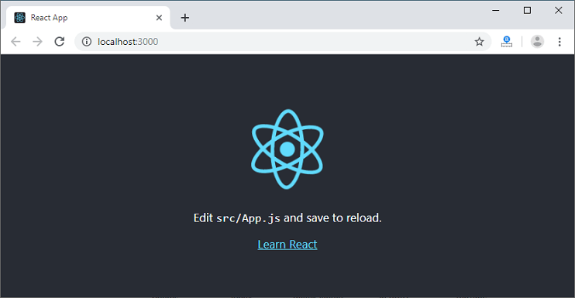

Slide 21
React Features

Slide 22
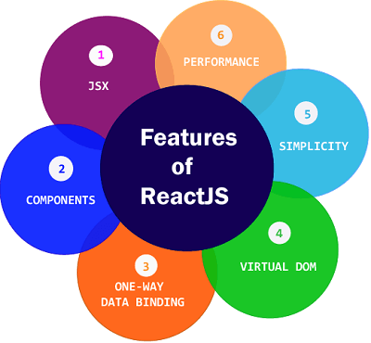
React Features

